Slide 1
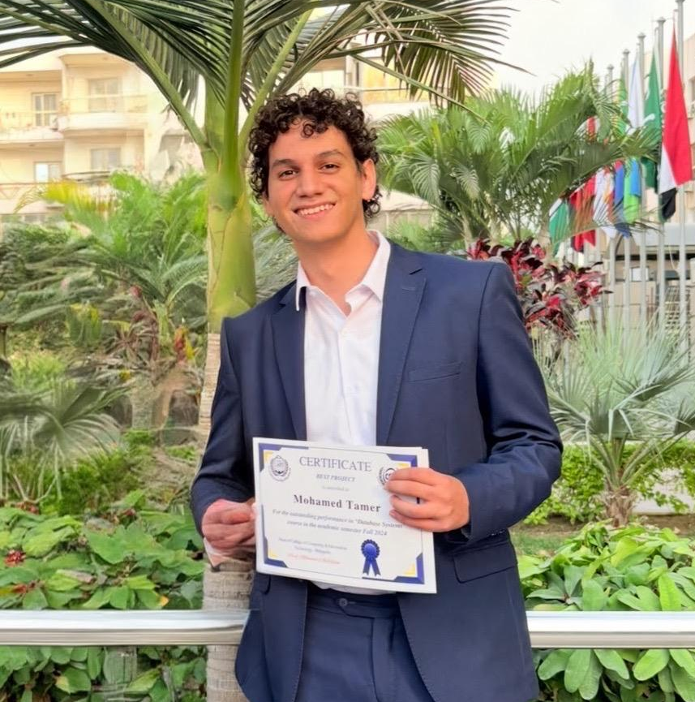
Hello, I’m Mohamed Tamer, a Data Analyst and Scientist
Welcome to my portfolio! I’m Mohamed Tamer, a data analyst and business intelligence developer driven by a passion for discovering insights hidden within data. Take a look at my projects, skills, and experience to see how I can support your organization in making smarter, data-driven decisions.

Slide 2
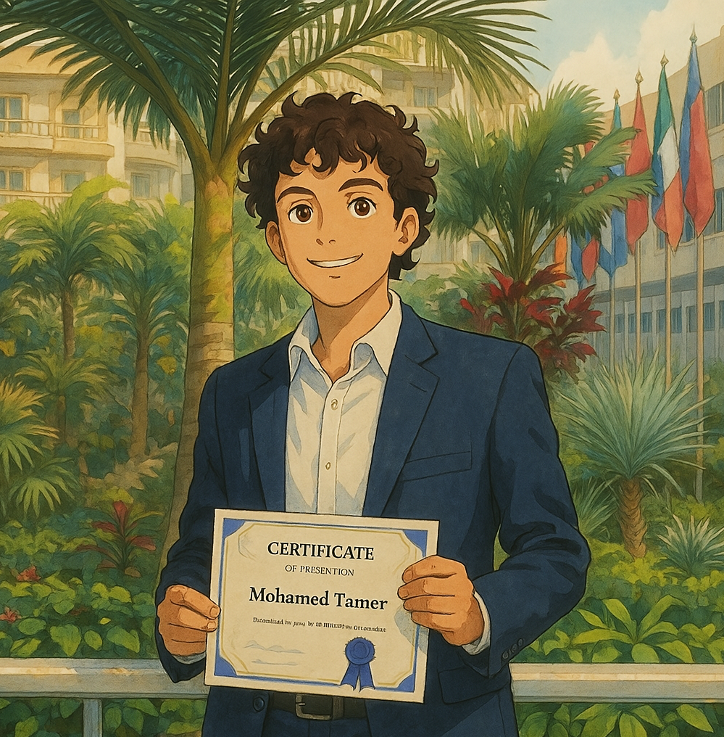
Table of contents
01
02
03
04
05
06
Introduction
Education & Background
Technical Skills
Work Experience
Previous projects
Contact Me

Slide 3

02
Education & Background

Slide 4
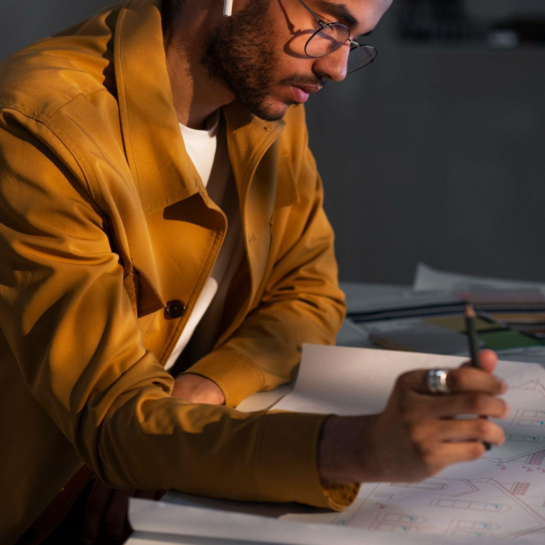
Education & Background
(2023-2027)
Arab Academy for Science, Technology and Maritime Transport (AAST) ,Computer Science
GPA: 3.5/ 4.0
(2020-2021)
INSTANT Software Solution ,AI Diploma
(2021-2021)
IBS Training Academy ,Self Development Course
(2022-2022)
AMIT Learning ,Flutter Diploma
(2024-2024)
CLS Learning Solutions ,CCNA Diploma

Slide 5
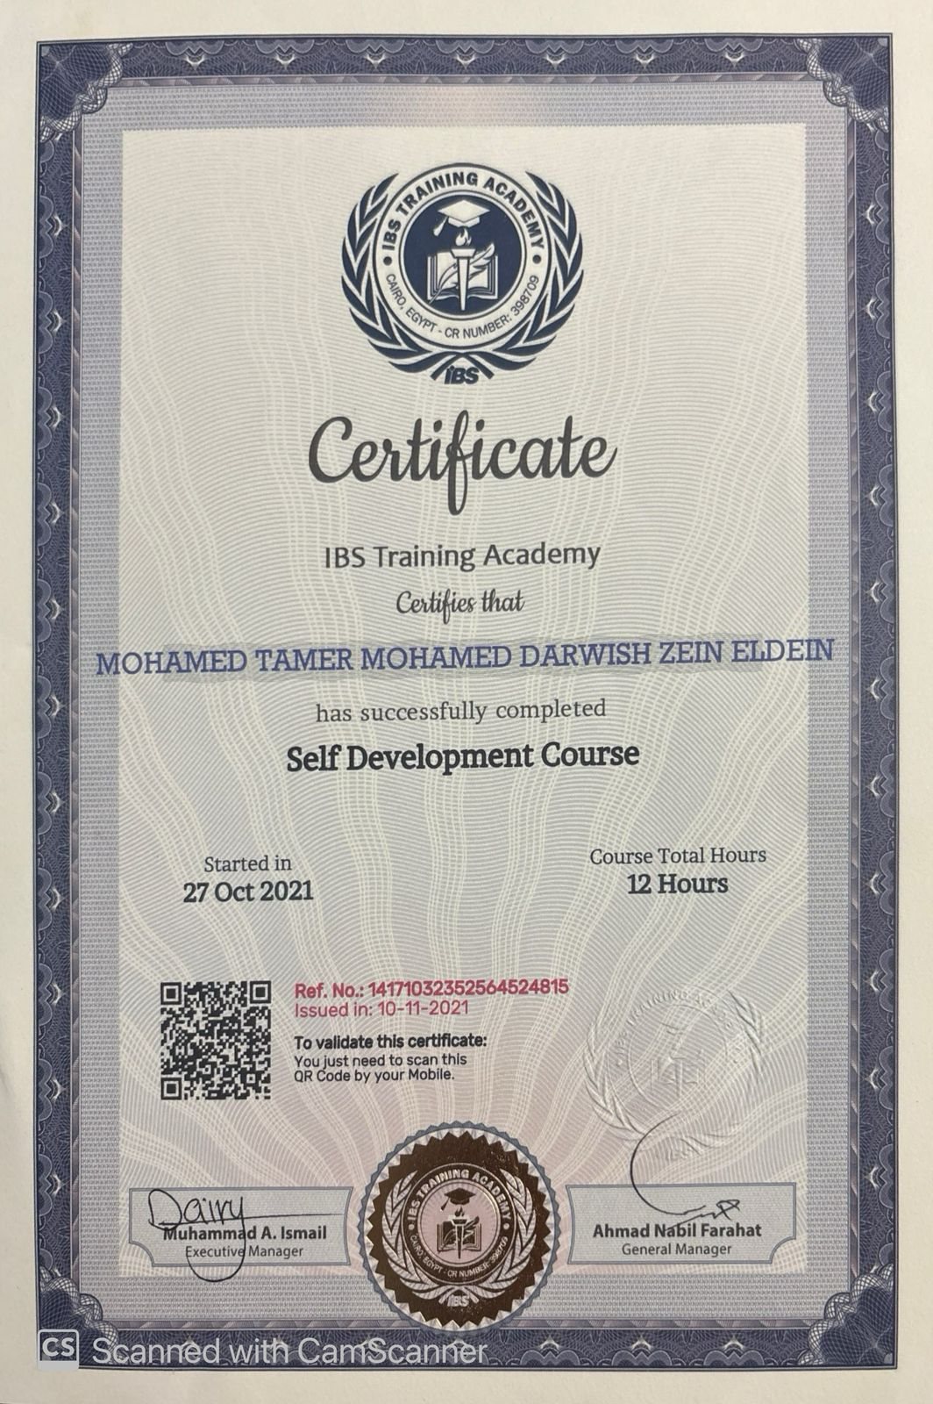
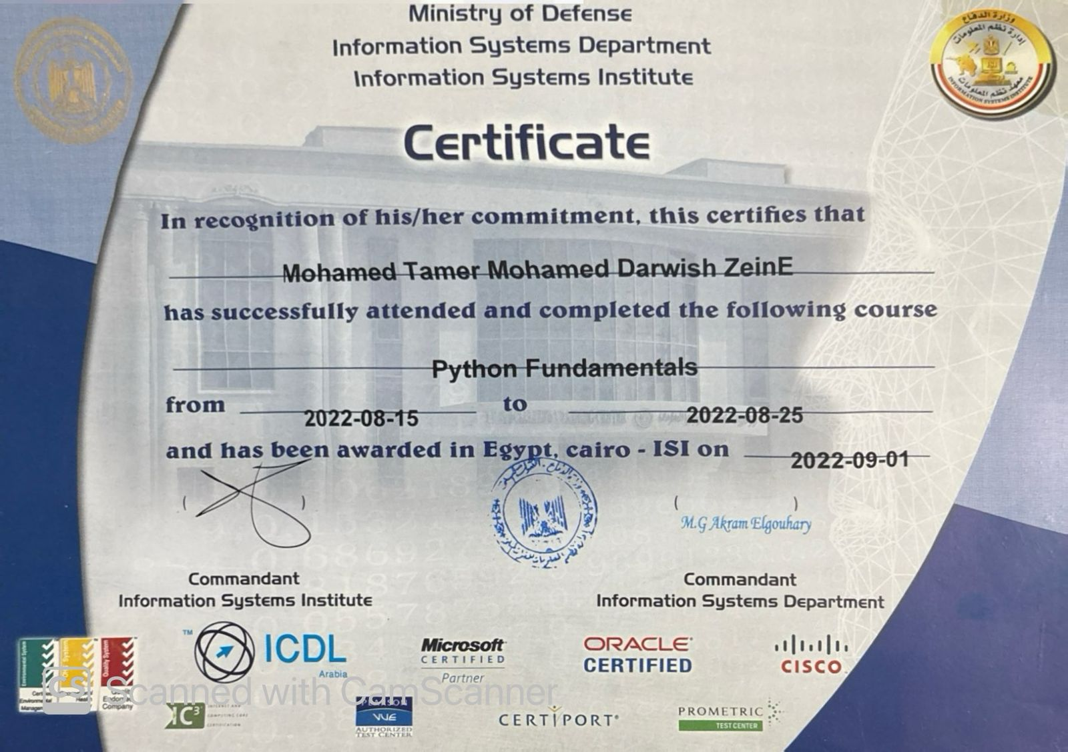
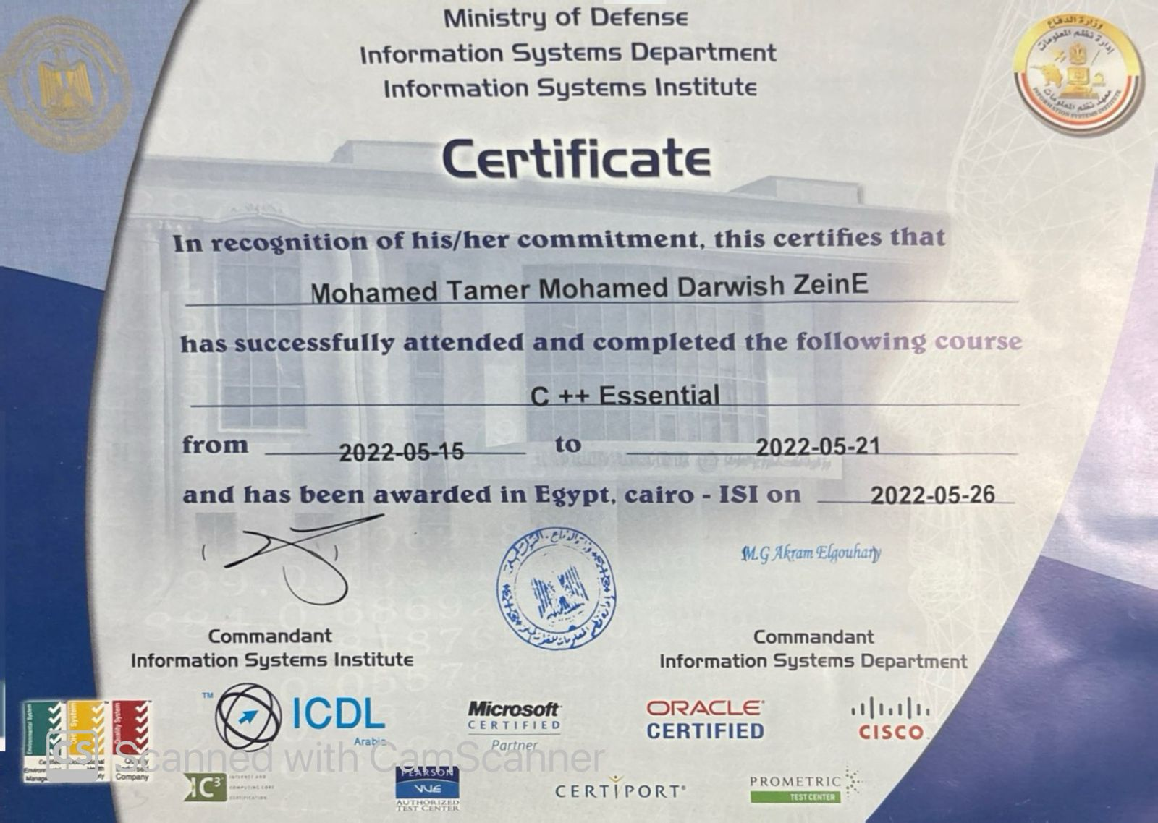
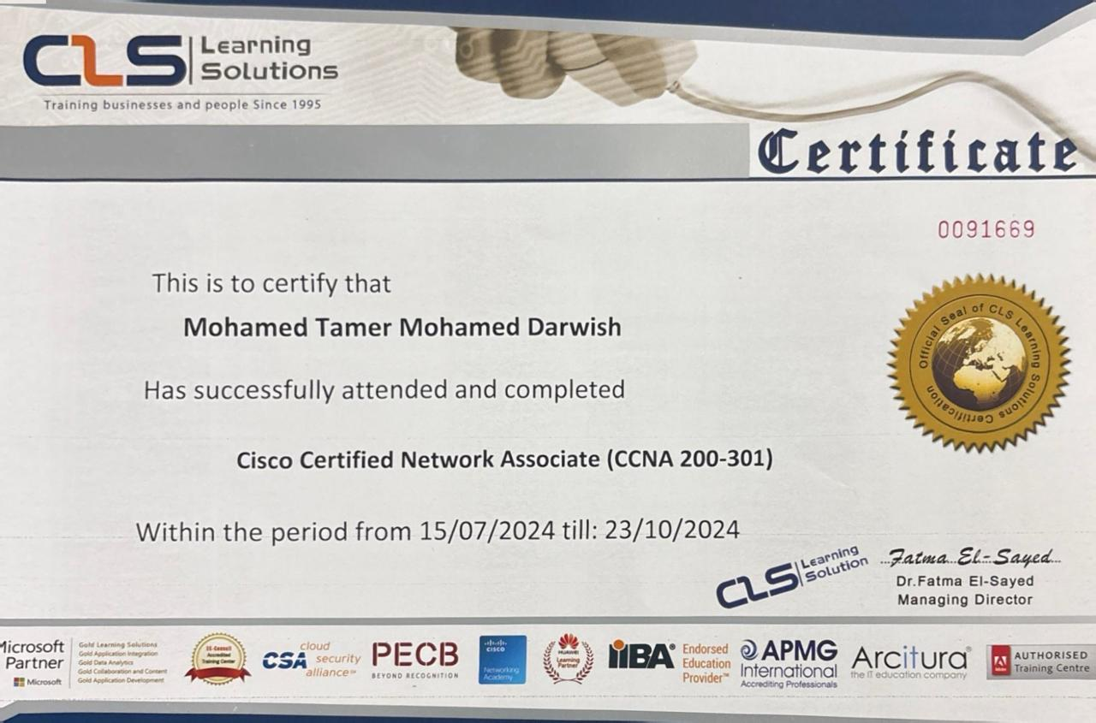
Education & Background

Slide 6
Table of contents
03
04
05
06
Technical Skills
Work Experience
Previous projects
Contact Me

Slide 7
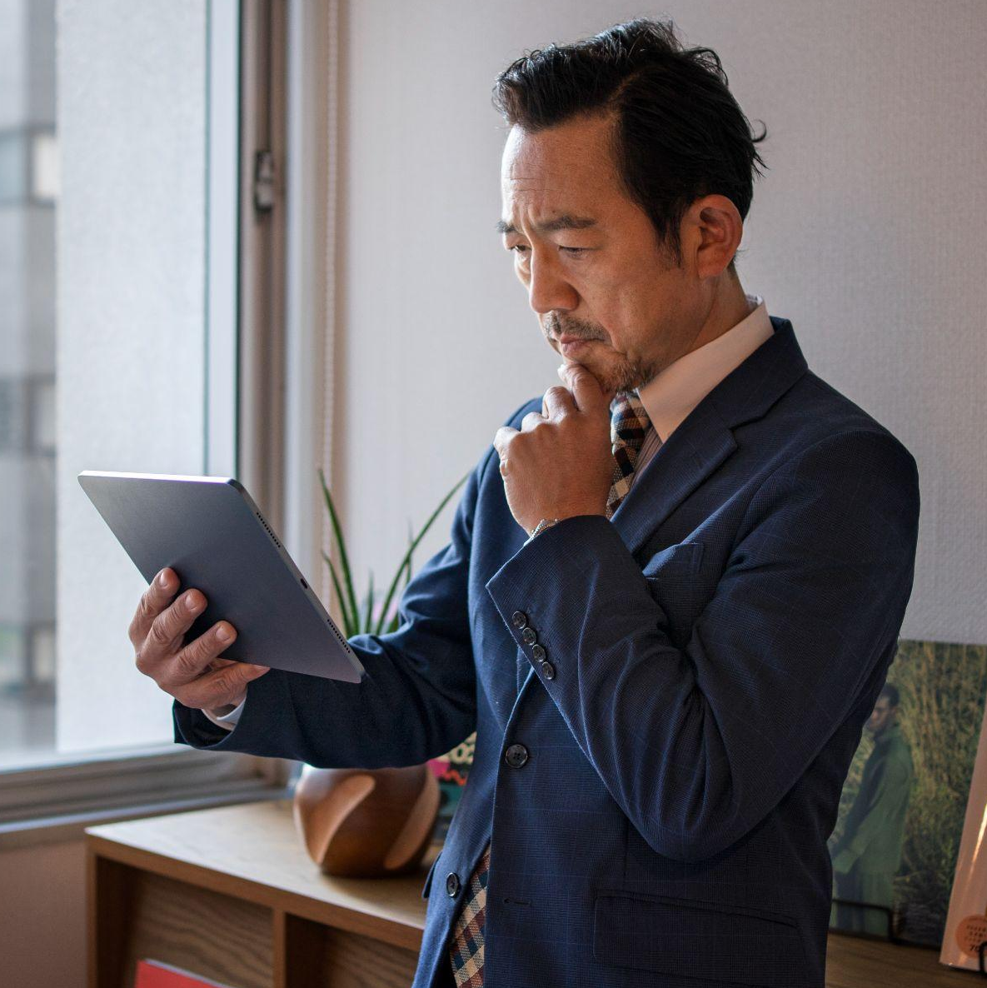
03
Technical Skills

Slide 8


















Technical Skills
Programming Languages
Java
Python
C / C++
HTML CSS
JavaScript
SQL & MySQL
Dart
Development Tools & Frameworks:
Flutter
(Mobile App Development)
Cisco Packet Tracer
(Networking Simulation)
Bootstrap
(Web Development Framework)
ICDL
Docker
Microsoft Power Bi
(Data Visualization)
Tableau
(Data Visualization)
Microsoft Access
(Database Management)
Github
Operating Systems & Platforms:
Linux
Windows

Slide 9
Soft Skills
Leadership
Problem-solving
Communications
“I possess leadership abilities that have been sharpened through past roles where I was responsible for the teams”
“My problem-solving capabilities have enabled me to solve difficult issues in the past, using creative, innovative solutions”
“With excellent verbal and written skills, I can effectively convey complex messages to a variety of audiences"
Organization
Technical skill
Interpersonal skill
“My proactivity allows me to plan ahead and prioritize tasks according to objectives and different deadlines"
“I am knowledgeable in several technical areas such as programming languages that support my ambition in my field"
“Teamwork is one of the essential part of my daily job, and I am sensitive towards different cultures"

Slide 10
Table of contents
04
05
06
Work Experience
Previous projects
Contact Me

Slide 11

Work Experience
04

Slide 12

Work Experience
AI Internship | Informatique
Desktop Application For Mobile Shop | Grab w Screena
Duration: Jul 2024 – Sep 2024 | Location: Nasr City Cairo, Egypt
Built a desktop app to manage mobile shop operations including sales, inventory, and client tracking.
Conducted a comparative study of chatbot platforms and selected the most efficient solution.
Designed and integrated a database system (SQL/MySQL) for streamlined operations.
Developed and deployed a chatbot integrated with a Flutter mobile app.
Enabled voice response features using Python, enhancing user interactivity.
Tech Used: Java, MySQL, GUI Design, Database Integration
Tech Used: Python, Flutter, AI, Voice Recognition, UX Design

Slide 13
In Progress Work
E-Commerce Website | Easy Organizer
Duration: May 2025 –
My team and I are currently developing an e-commerce website for a local Egyptian brand that specializes in organizational products. The project involves building a responsive and user-friendly platform to showcase and sell the brand’s items online. We are handling everything from the UI/UX design to full-stack development, including user authentication, product management, and secure payment integration.
Tech Used: UI/UX Design ,HTML, CSS, JavaScript, PHP, MySQL ,Bootstrap, Tailwind

Slide 14
What people say about me
Advisor In The Internship
Grab&Screena Owner
“I have been impressed by the quality, attention to detail and how fast we finish the project”
“The app is friendly and easy to use and helped me to oraganize my work”

Slide 15
Table of contents
05
06
Previous Projects
Contact Me

Slide 16
Previous Projects
05

Slide 17
Previous Projects
AI & Chatbot Integration Projects
Desktop Application for Mobile Store
“I was responsible for conducting a comparative analysis of chatbot technologies and selecting a cost-effective solution during my internship at Informatique. I developed and integrated a chatbot into a Flutter application, enabling voice response using Python. This enhanced user interactivity while maintaining brand consistency across all digital channels.”
“At Gerab & Screena Mobile Shop, I developed a desktop application that streamlined mobile shop operations. I implemented a robust database system and ensured seamless integration between the chatbot and the desktop app. This improved both functionality and user experience in daily business operations.”

Slide 18
Table of contents
06
Contact Me

Slide 19
Contact Me
06

Slide 20



Contact Me
Mail: Click Here
LinkedIn : Click Here
Github: Click Here
Codeforces: Click Here
Hackerrank: Click Here

Slide 21



Thanks
Do you have any questions?
Mohamed Tamer

Slide 22
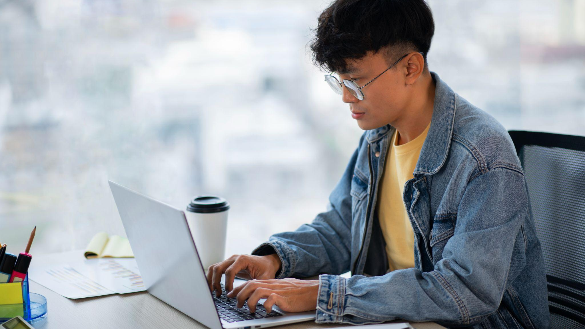
"Creativity is the key to unlocking your true potential"

